Slide 1
Let AI help you analyze performance issues in Dynamics 365 Business Central
June 2023 release of Power BI apps on telemetry

Slide 2
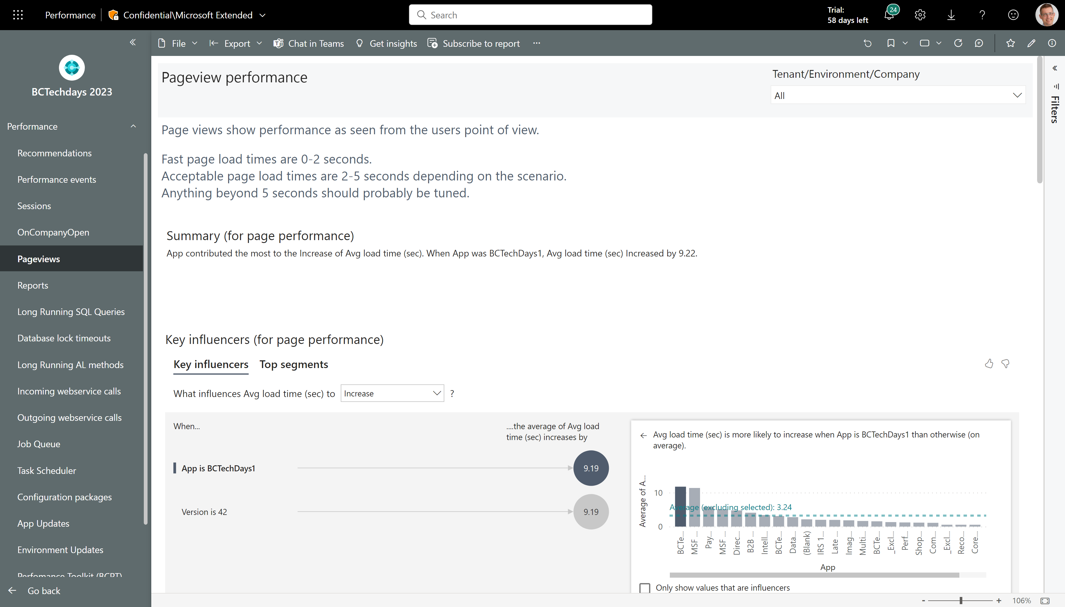
AI assisted performance analysis
Most pages in the performance report has these overview visuals:
An AI generated summary in English
AI generated key influencers to performance metrics
AI generated segmentation of the dataset for this page
An AI guided decomposition tree where you can analyze patterns
Top 10 slowest entities
Top 10 slowest entities over time

Slide 3
AI assisted performance analysis - summary
AI generated summary in English (might not show anything if there is not enough data for the AI to analyze.)

Slide 4
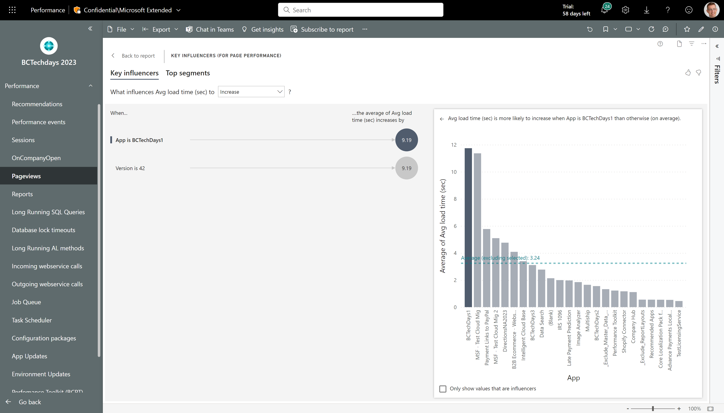
AI assisted performance analysis - key influencers
AI generated key influencers to performance metrics (might not show anything if there is not enough data for the AI to analyze.) Click on an insight to compare to the average of the full population.

Slide 5
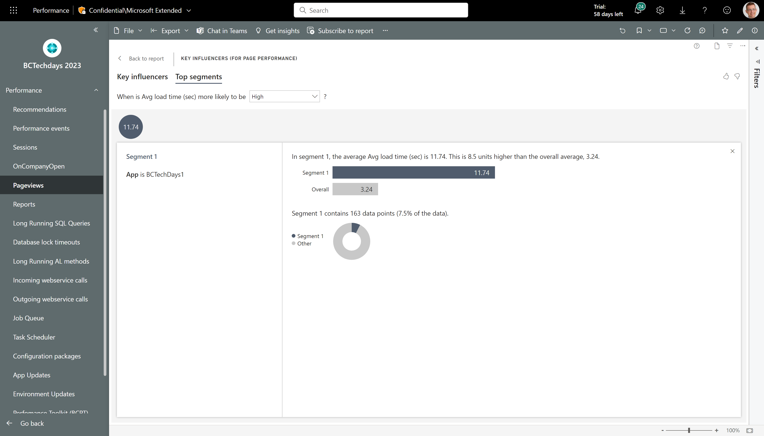
AI assisted performance analysis – Top segments
AI generated segmentation of the dataset for this page (might not show anything if there is not enough data for the AI to analyze.) Click on a segment to learn more

Slide 6
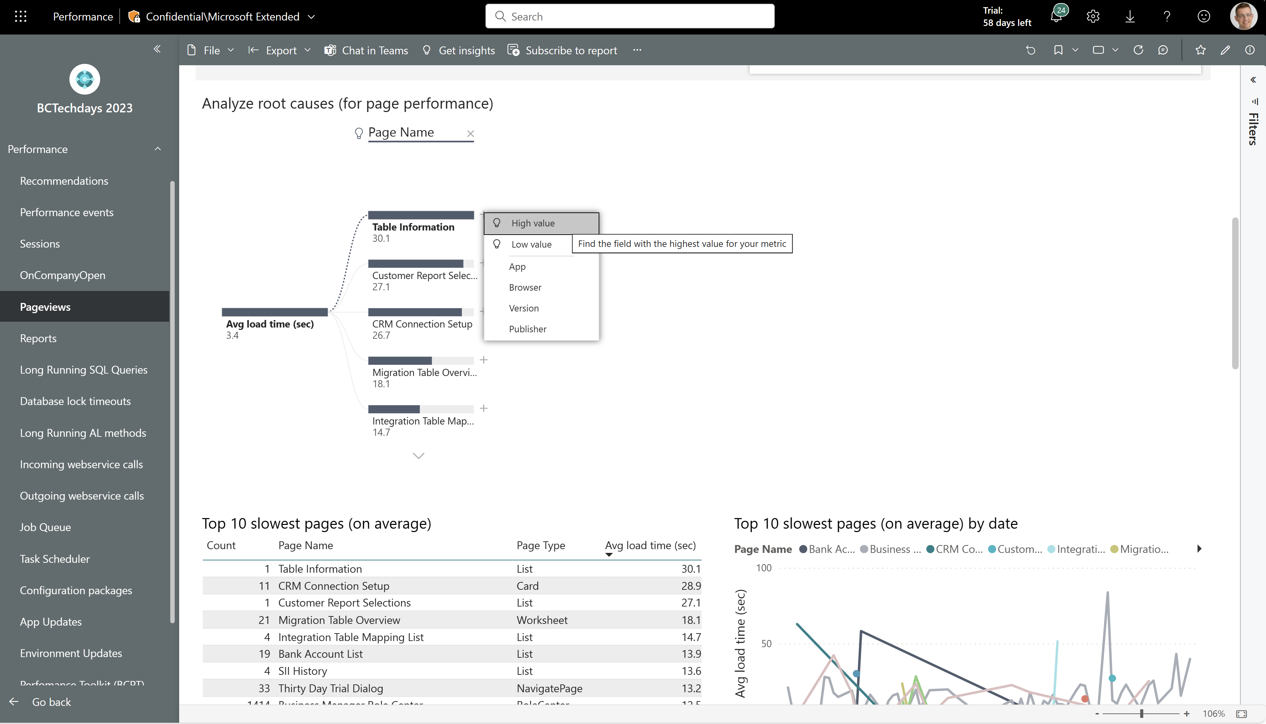
AI assisted performance analysis – Analyze root causes
An AI guided decomposition tree where you can analyze patterns.
Let AI pick the next step (see the light bulp icons) or pick the dimension you want to explore.

Slide 7
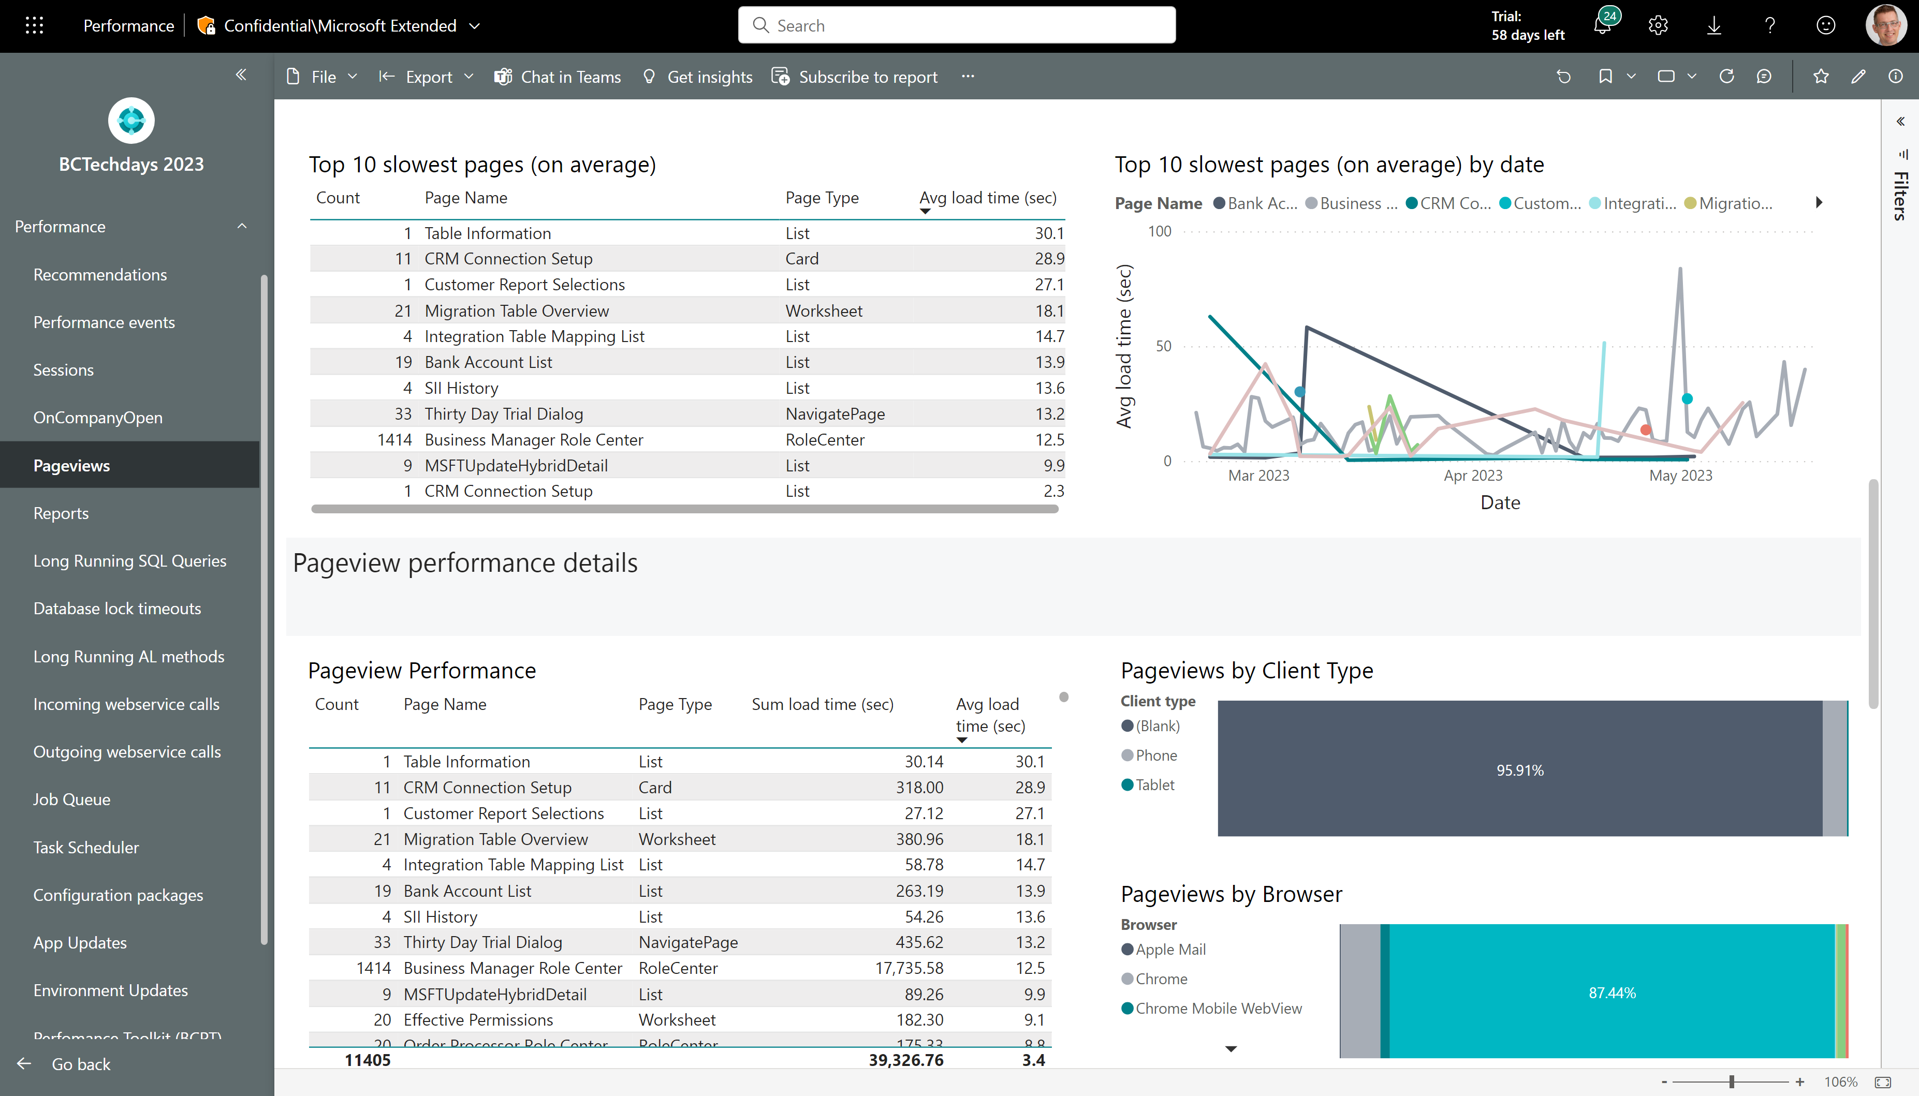
AI assisted performance analysis – Top 10 slowest
See top 10 slowest entities (on average) and top 10 slowest entities over time
Pick one row and then scroll down to the detail report (which is now filtered to your choice)

Slide 8
Other performance troubleshooting improvements
June 2023 release of Power BI apps on telemetry

Slide 9
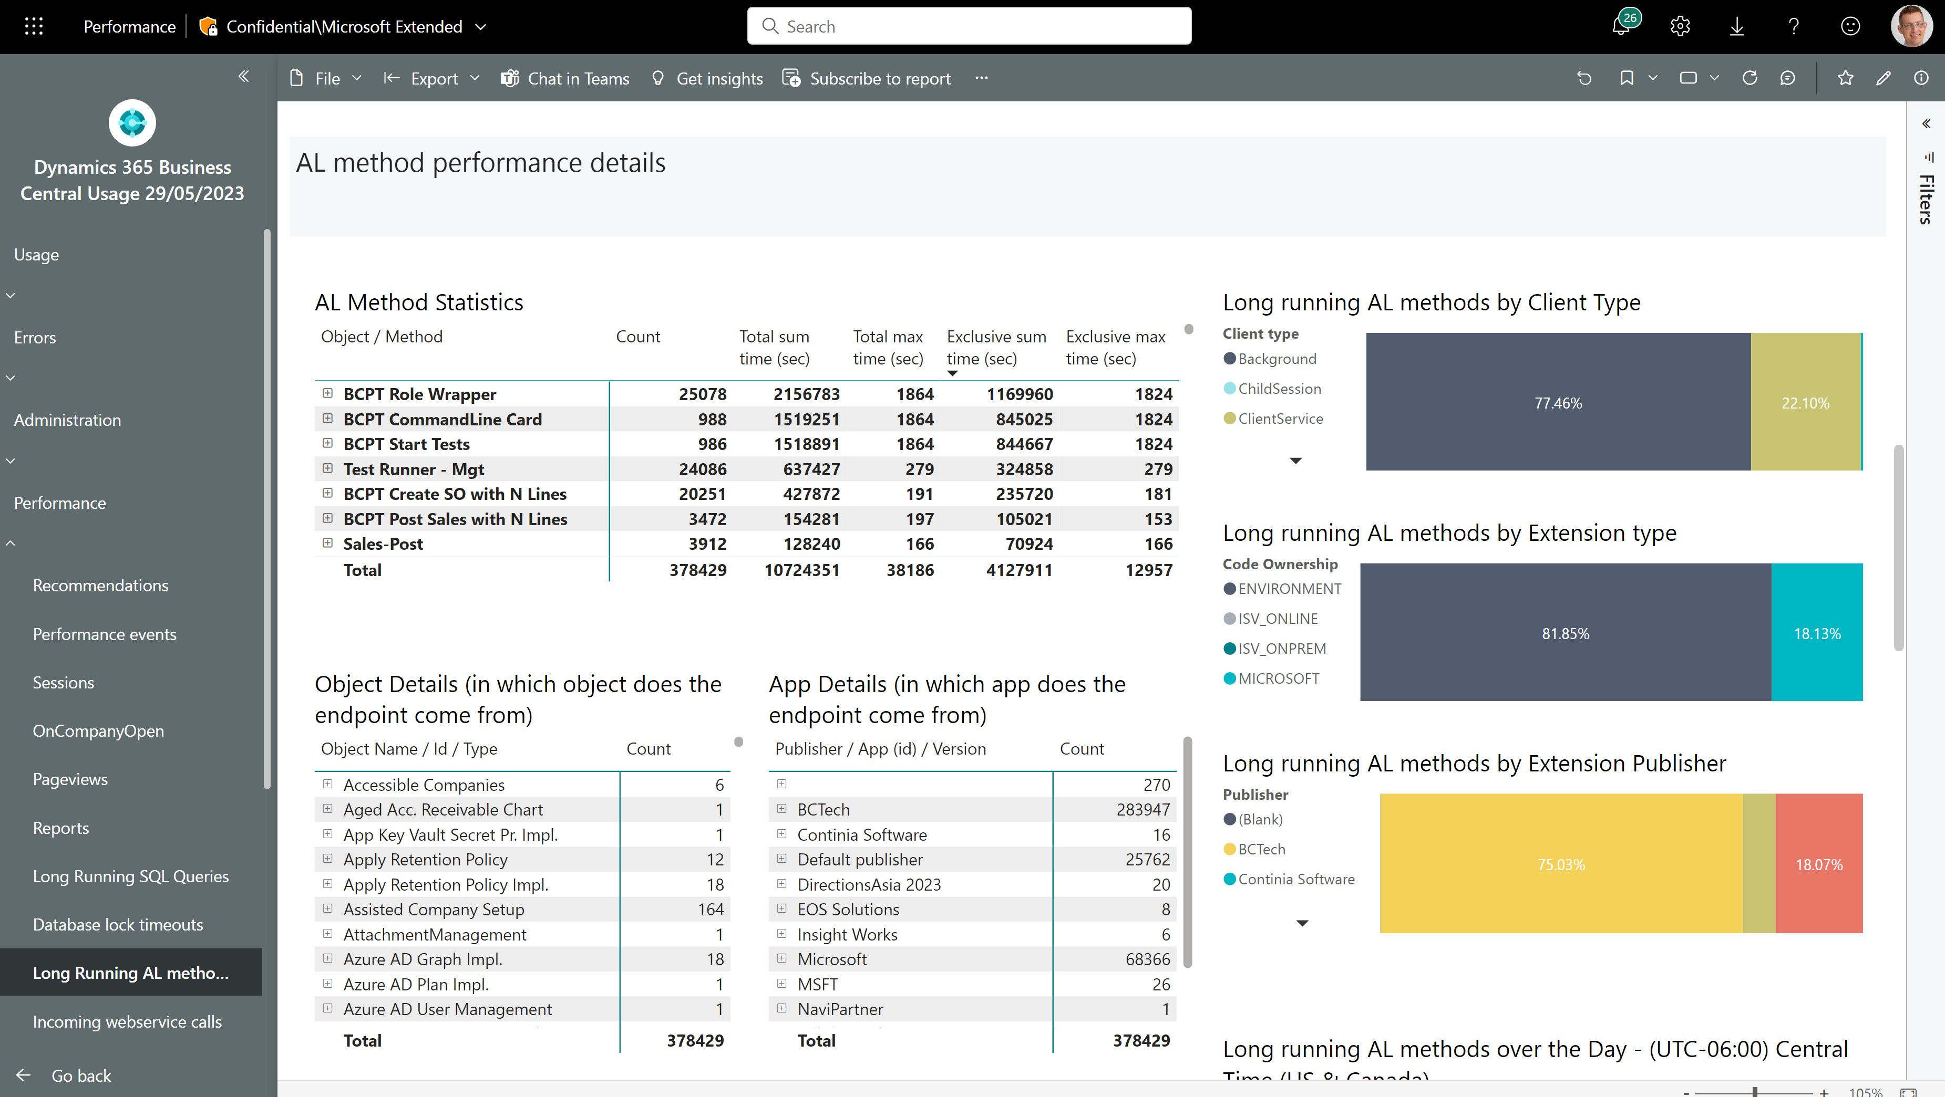
Long running AL methods
Now shows both total time and exclusive time

Slide 10
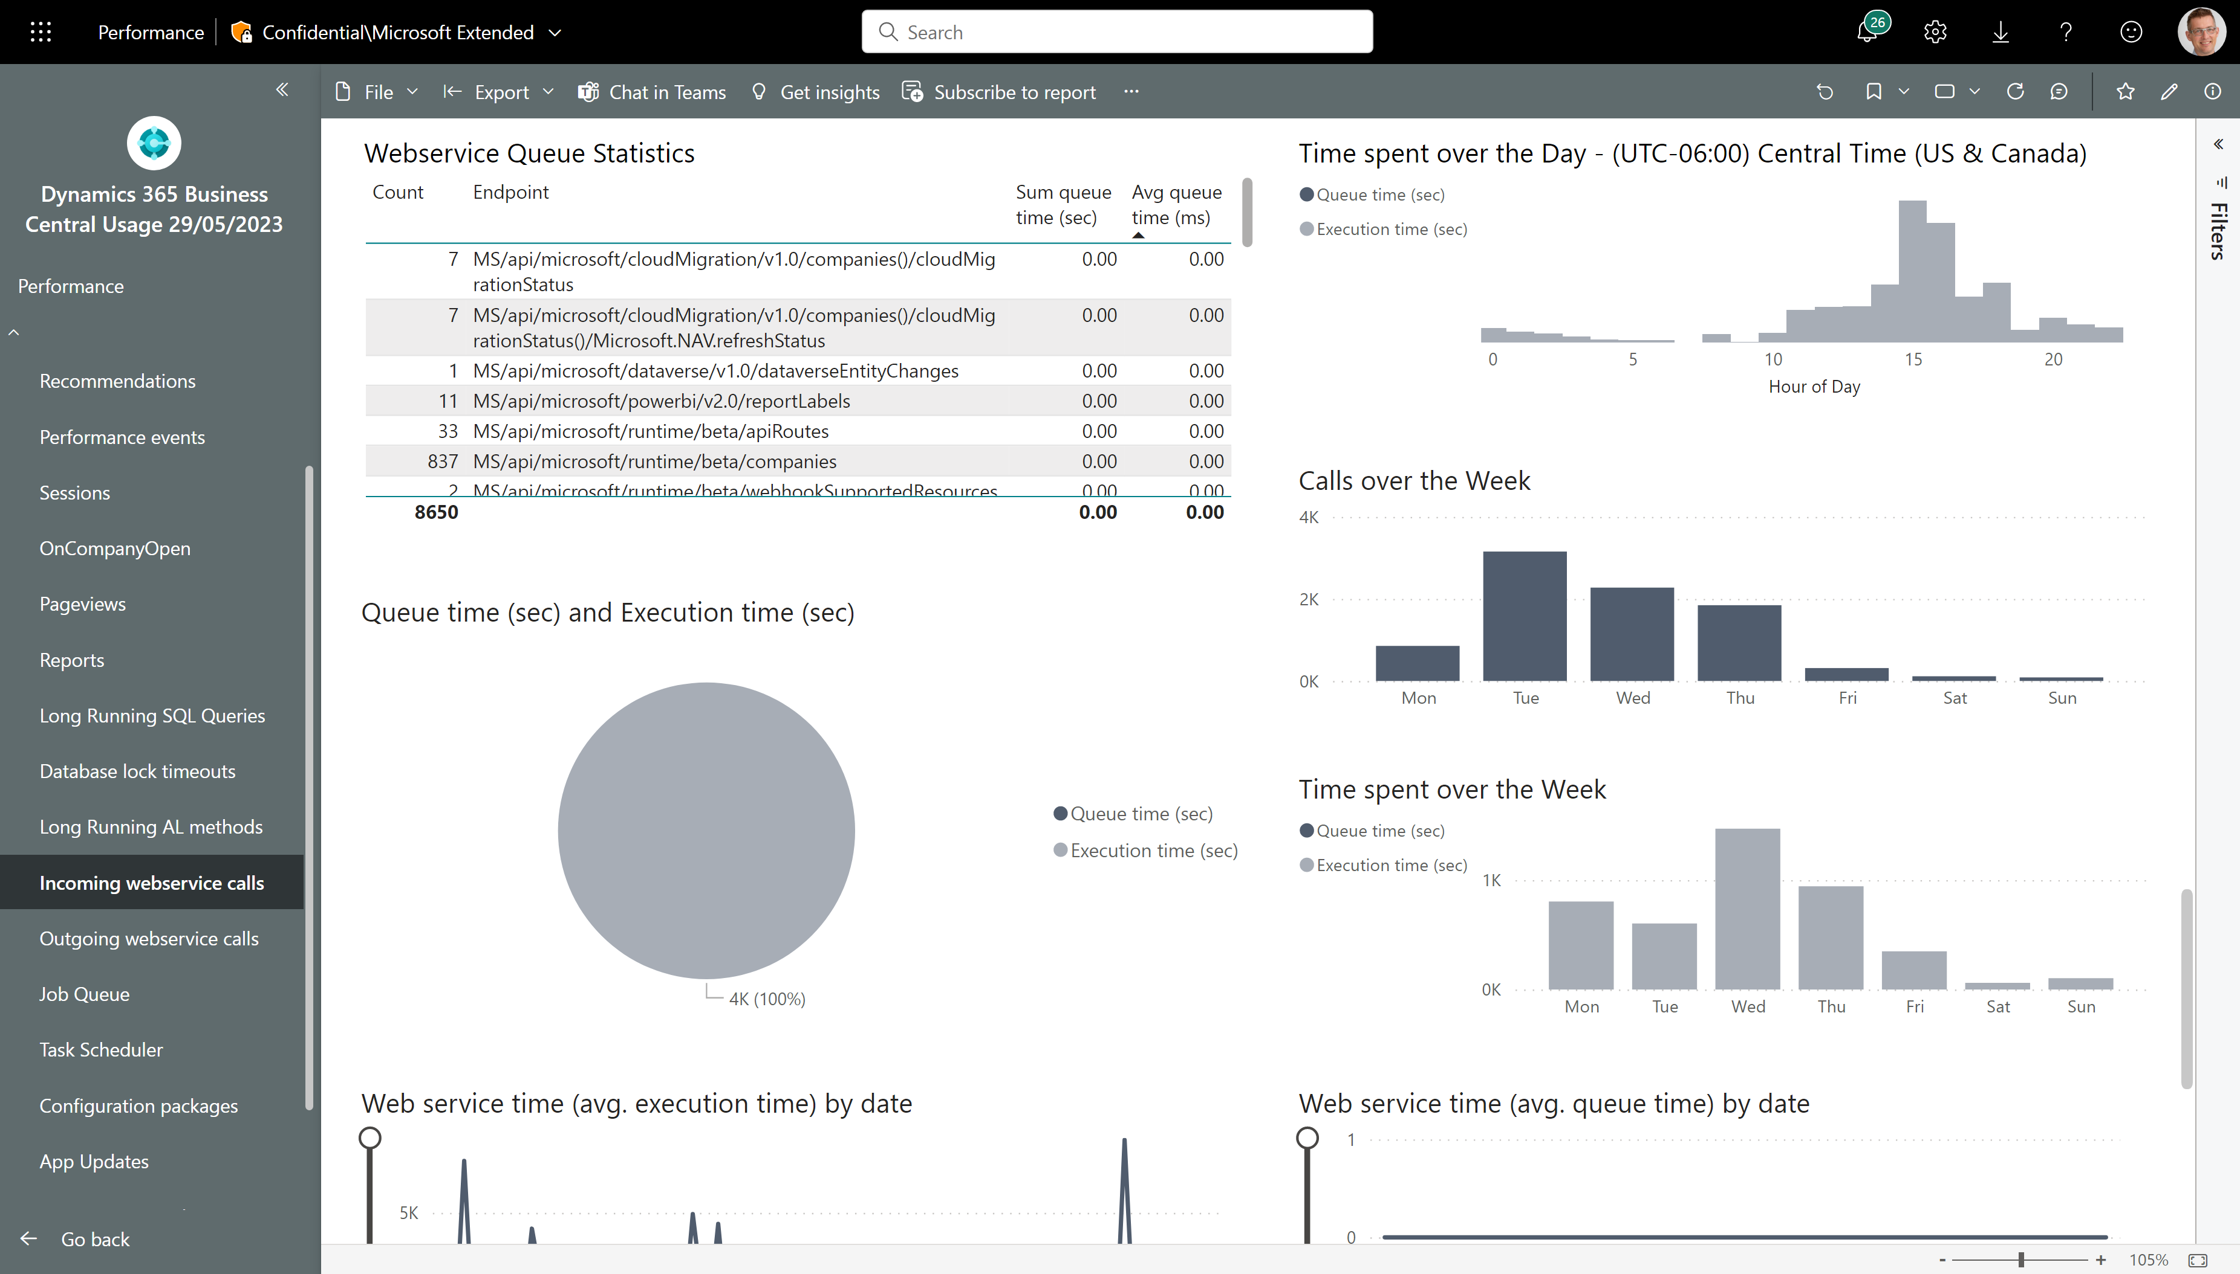
Does your API calls get queued up?
Queue time statistics, anyone?

Slide 11
Troubleshoot web service calls
June 2023 release of Power BI apps on telemetry

Slide 12
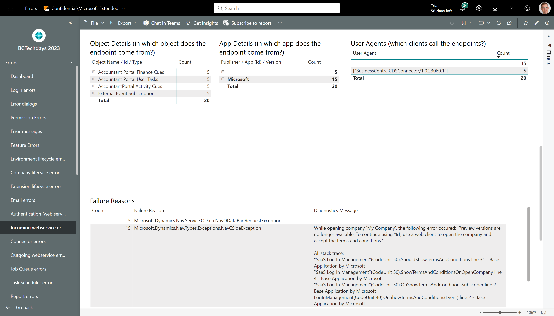
Troubleshoot web service calls
Which web service client experienced issues?
Which exception was thrown by the server, what was the AL error and AL stack trace (if available)?

Slide 13
Get the apps from Appsource
For environment telemetry https://aka.ms/bctelemetryreport
For app telemetry https://aka.ms/bctelemetry-isv-app

